Slide 1
コロイド及び界面化学部会設立５０周年
に寄せて
「コロイド科学に疎い私の部会との接点と挑戦」
金子克美
Katsumi Kaneko
アクア・リジェネレーション機構
信州大学 Shinshu University
The 50th Anniversary Session
of Division of Colloid and Surface Chemistry
The 76th Divisional Meeting of DCSC, CSJ
September 23, 2025
Chiba Okura Hotel

Slide 2
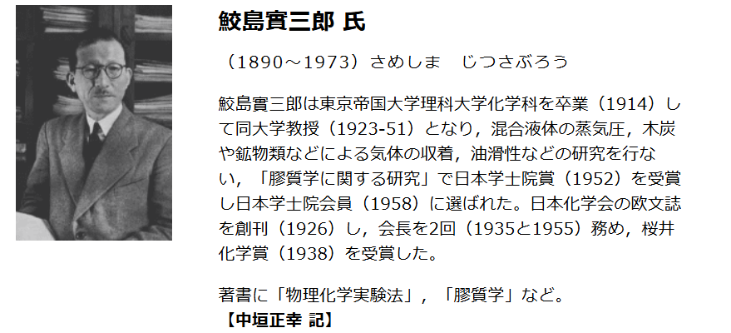
コロイド・界面化学部会：コロイド偉人館より
Professor J. Sameshima, Univ. of Tokyo
コロイド偉人館より
ゼオライトの吸着特性のパイオニア
Pioneering studies on zeolites
1948: 第一回膠漆学討論会

Slide 3
コロイドおよび界面化学部会
1968年 コロイド討論会から
「コロイドおよび界面化学討論会」に変更
1976年に「コロイドおよび界面化学部会」発足
金子：コロイドおよび界面化学討論会になってから参加
１９７１年： 千葉大学理学部に就職
鉄系酸化物コロイドー電気物性と気相環境
（大学院修士：有機半導体の分光学）
“コロイド系は複雑系で研究対象として興味”

Slide 4
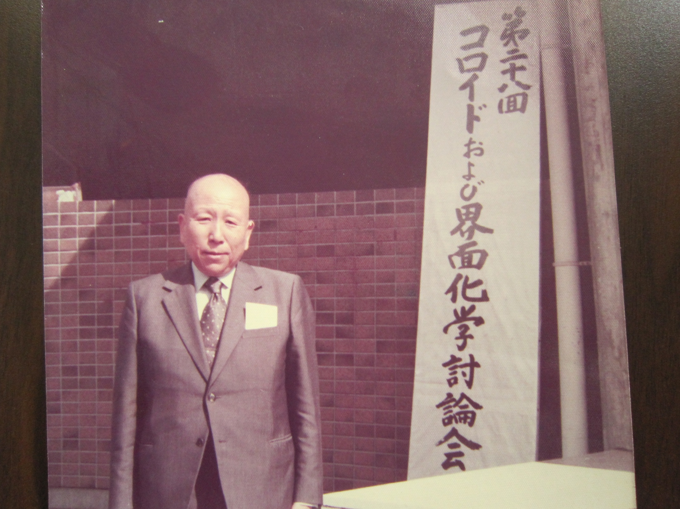
1975 岡山大理学部
赤松先生

Slide 5
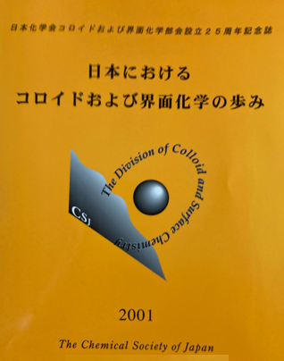
部会２５周年記念:2000（発行は2001)
コロイド・界面化学の変遷
関連分野からみたコロイド・界面化学
２１世紀にかける夢と課題
２１世紀に向けた環境問題の課題
環境保全に向けてのコロイド/界面化学の貢献
宝の箱―２１世紀のコロイド科学に夢を託してー
次なる１００年コロイド・界面科学は何を明らかに
できるのか
宇宙船地球はコロイド系
２１世紀を迎えてのコロイドおよび界面化学への
期待
若手研究者座談会
コロイド界面科学国際会議
2000年11月 東京 市ヶ谷 岩澤康裕委員長
金子：部会長２００１ー２００２
部会長 辻井薫博士
記念誌出版委員会

Slide 6
第76回 コロイドおよび界面化学討論会
主題：コロイド・界面化学とAI
アカデミックプログラム
(1)総合講演、受賞講演 総合講演およびLectureship Award受賞講演
奨励賞受賞講演 オークラ千葉ホテル
(2)一般研究発表（口頭およびポスター）
①界面活性剤と両親媒性物質、②分子膜、
③ソフトマターとバイオシステム、④微粒子・ナノ粒子・
ナノマテリアル、⑤分散・凝集、
⑥固体表面と濡れ・吸着・接着
(3)一般シンポジウム
(4)国際シンポジウム
(5)企業展示セッション
若手の会

Slide 7
Colloid Science and Nanoscience
ASTM
1 10 100 1000/nm
Nanoscience
Nanoparticles
Nanostructures
Molecule-
nanostructure
interaction
< 10 nm
Nanostructures-
Nanoscale
environment
interaction
ナノレベルでの粒子間の構造と
状態、ナノ領域の周辺との
相互作用とを重視
Colloids
Interparticle interaction
Particle-medium
interaction
Interfaces
Surface tension
ASTM:American Society for Testing and Materials
米国材料試験協会

Slide 8
1. 界面活性剤と両親媒性物質
実体
実体
2. 分子膜
実体
3. ソフトマターとバイオシステム
実体
実体
4. 微粒子・ナノ粒子・ナノマテリアル
5. 分散・凝集
実態
6. 固体表面（実体）と濡れ・吸着・接着（実態）
物質材料科学ー複雑系・多相系・揺動系
物質科学 状態科学 境界科学
平衡 かつ 非平衡
研究・基礎教育に必須の領域
部会活動は本質的に重要

Slide 9
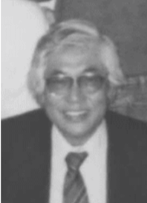
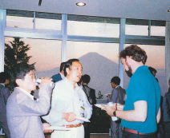
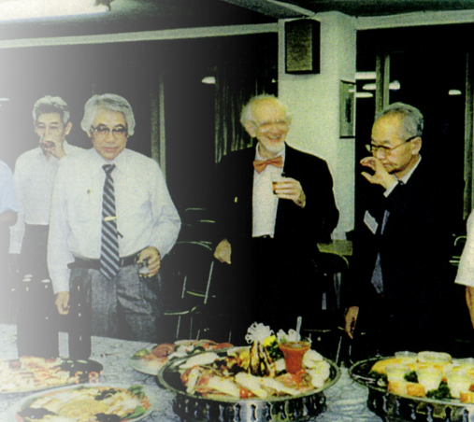
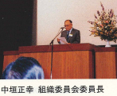
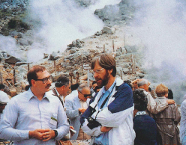
第6回IACIS国際会議（箱根仙谷原）1988 6th International Association of Colloid and Interface Scientists Conference (IACIS 1988)
目黒謙次郎教授（東京理科大）
Professor K. Meguro (Tokyo Science Univ.)
コロイド偉人館より
目黒先生
阿部正彦
東京理科名誉教授より
第６回界面及びコロイド科学国際会議
報告書 日本化学会・国際会議組織員会

Slide 10
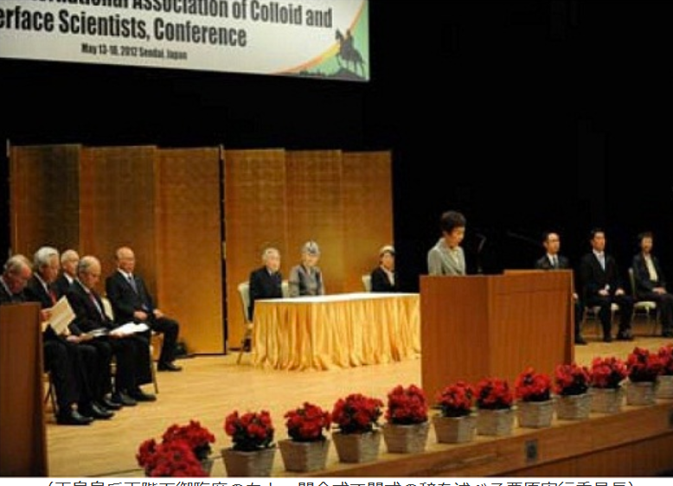
第１４回IACIS国際会議(仙台） 14th International Association of Colloid and Interface Scientists Conference (IACIS2012)
栗原良枝教授 東北大学
Professor Y. Kurihara Tohoku Univ.

Slide 11
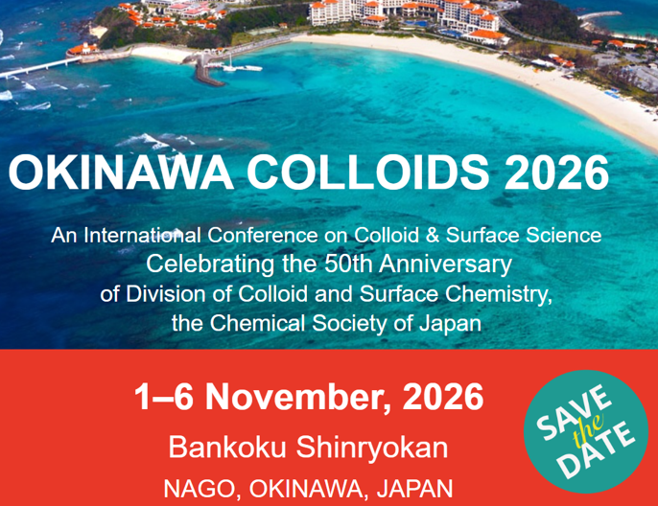
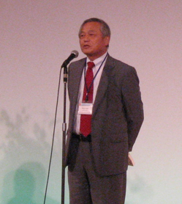
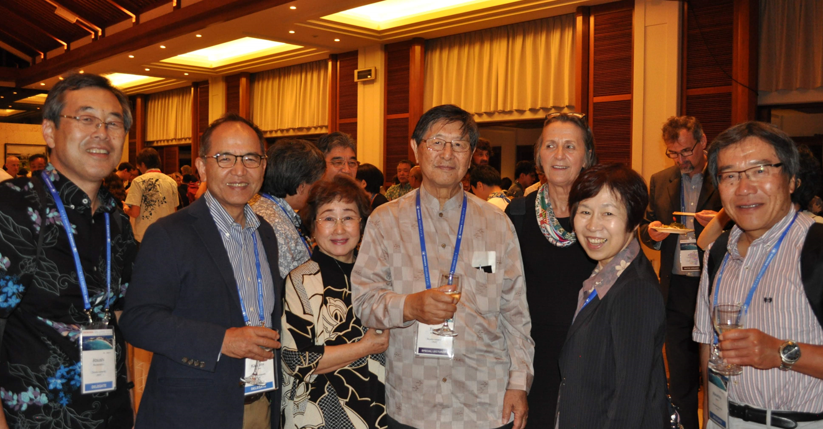
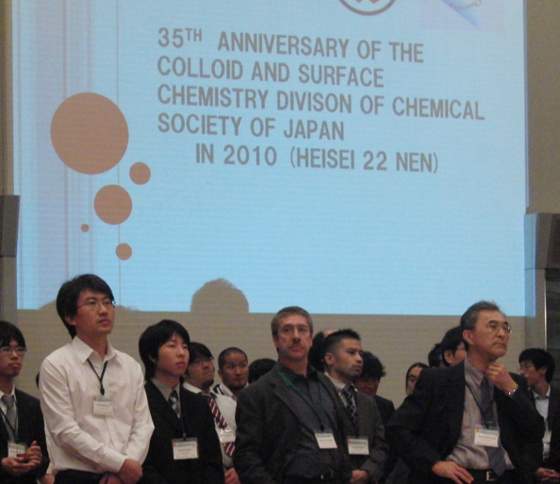
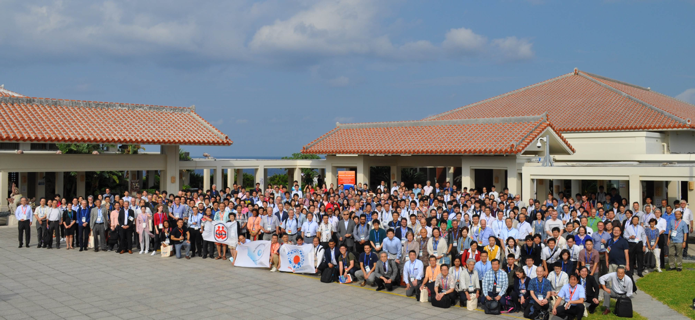
35th Anniversary
in Chiba: 2010
Nanoscopic Colloid-
Surface Chemistry
国際発信
国際拠点化
Peakを
50th Anniversary 2026
Okinawa 2019

Slide 12
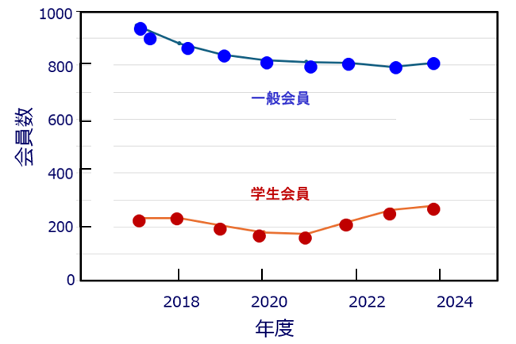
部会員数の推移
最近の人口減の傾向
酒井秀樹教授（東京理科大）のご協力による

Slide 13
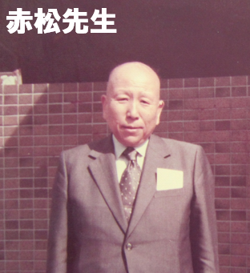
君たちはden（ほら穴）に籠り新しい学問を
創りなさい
分子科学とコロイド科学の素養
のもと、吸着と炭素科学から
固体内に隠れた小さなスペースの分子・物質科学を目指す
教育は大事
赤松教授は有機半導体の
パイオニア

Slide 14
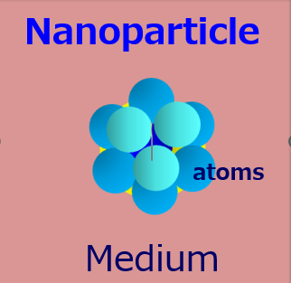
Nanoparticles and In-solid Nanospaces
Nanoparticle
Nanoscale
space
atoms
Medium
Solid

Slide 15
In-Solid Nanospace Effects
Invited paper: Unusual Molecular Behaviors in Subnanospaces, K. Kaneko et al.
MRS Fall Meeting (1994), Adv. in Porous Solids, 401 (1995)
In-pore superhigh pressure effect
Dimerization of NO molecules (20MPa） J. Chem. Phys., 87, 776 (1987).
High pressure phase KI formation (1.9 GPa), J. Amer. Chem. Soc. 133, 10344 (2011).
Atomically 1D S-chain structure formation (90 GPa) Nature Comm. 4, 2162 (2013).
Acceleration of methane hydrate formation, Nature Comm. 6, 6432(2015).
Dehydration or De-solvation effect
Rb⁺: 4 in pore, 6 in bulk (with EXAFS) J. Amer. Chem. Soc. 124, 11860 (2002).
De-solvation of organic electrolytes J. Amer. Chem. Soc., 129, 20-21 (2007).
Separation of KCl from water inside SWCNT J. Phys. Chem. C, 128, 12632 (2024).
Permeation of dehydrated ions through nanowindows, Carbon, 213,118287 (2023).
Solidification or suppression of molecular motions
Ice like structure of water in carbon pores J. Phys. Chem. 99,10075 (1995).
Freezing of rotational motion of CH₄ J. Amer. Chem. Soc. 133, 2022 (2011).
Hydrophobic-hydrophilic transition in water adsorption in carbon pores
Interaction potential for water clusters, J. Amer. Chem. Soc. 126, 1560 (2004).
Stability of water nanoclusters, Nano Lett., 5, 227 (2005).
Cluster-associated hydrophobic-hydrophilic transition, Nature Chem. 7, 194 (2015).
Isotope-recognition type adsorption: Quantum effect in adsorption
Excitation of translational motion of He at 4 K, Stud. in Surf. Sci. Catal. 87, 593(1994)
Different adsorptivity of H₂ and D₂ at low temp J. Amer. Chem. Soc., 127, 7511(2005).
¹⁶O₂ and ¹⁸O₂ separation with low temp. adsorption Nature Comm. 12:546 (2012)
D₂O phobicity of hydrophilic spaces Nature Comm. 15 , 3585 (2024).

Slide 16


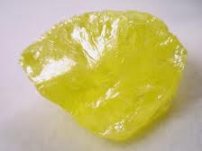
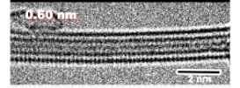
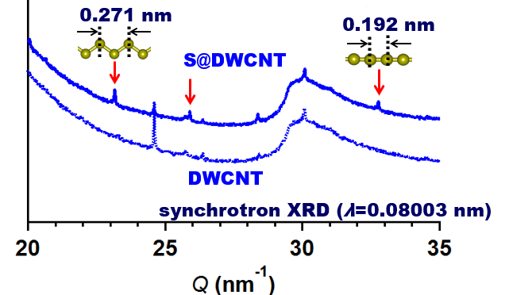
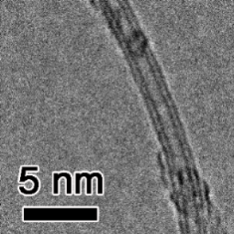
In-Pore High Pressure corresponding to 90 GPa
Insulator
Metallic phase of sulfur
Bulk
zigzag chain
R. Steudel Ed., “Elemental Sulfur and Sulfur-Rich
Compounds I” (Springer, 2003).
90 GPa
S
1D S-chain
< 0.1MPa
In-pore
synthesis
SWCNT
at 773 K
DWCNT
DWCNT
b.c.o
T.Fujimori et al.Nature Comm. (2013)

Slide 17
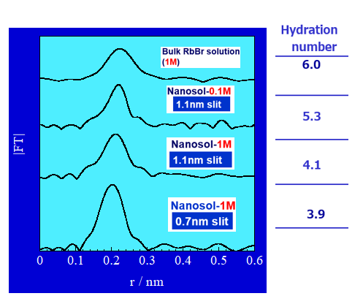
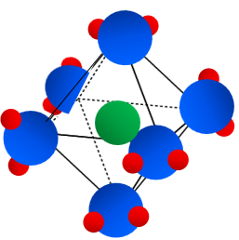
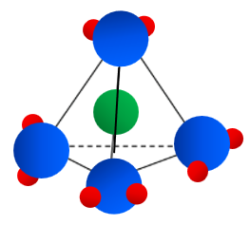
Dehydration of ions from EXAFS
RSFs of nanosolution around a Rb ion
Rb
in bulk solution
Dehydration
in hydrophobic
nanospaces
Inside pore
T. Ohkubo et al. J. Amer. Chem. Soc. 124, 11860 (2002).

Slide 18

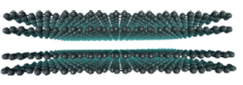

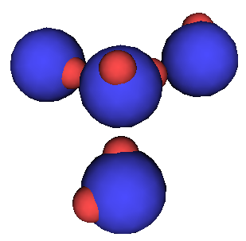
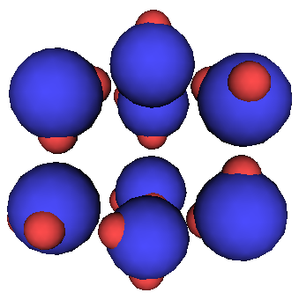
Apparent Hydrophobic-Hydrophilic
Transformation
hydrophilic
吸着ほぼなし
Hydrophobic nature
A water droplet
hyrdophopic
Carbon
Cluster-associated filling mechanism
Carbon micropore
Hydrophobic
hydrophilic
T. Ohba et al. J. Amer. Chem. Soc. (2004). Nano Lett. (2005) Nature Chem. (2015)

Slide 19
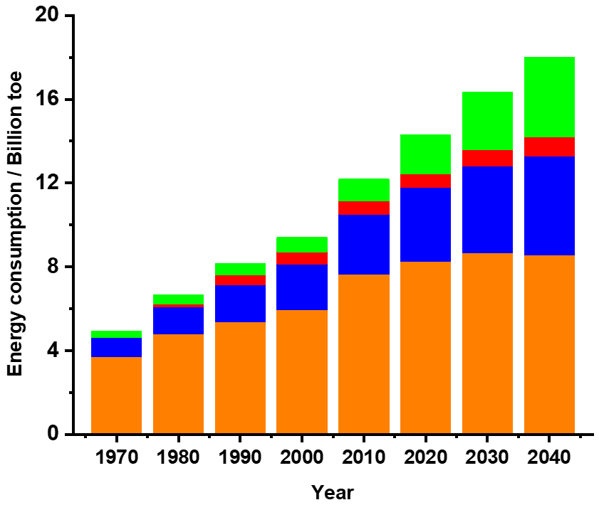
Promotion of Renewable Energy Technologies
Energy Consumption (BP Energy Outlook, 2018, p.14)
Renewable
energy
Nuclear
Natural gas
Oil, Coal
Superefficient
coal energy technology
Nanoporous Materials for Gas Storage,
K. Kaneko and F. Rodriguez-Reinoso Eds. Springer, 2019

Slide 20
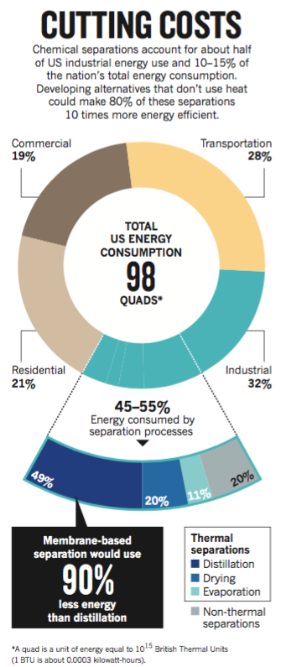
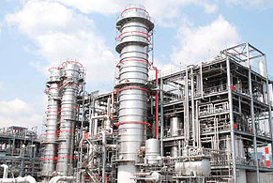
Energy for Separation of Chemicals is
about 50 % of Total Energy Used in Industries
http://enko.co.jp/product/index.html
1x10¹⁸ J
Energy consumption by
Distillation, Drying,
Evaporation
Energy Saving Separation
Technologies
Adsorption separation
Membrane separation
By D. S. Sholl, R.P. Lively,
Nature, 2016, 532, 435.

Slide 21

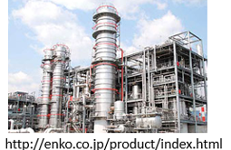
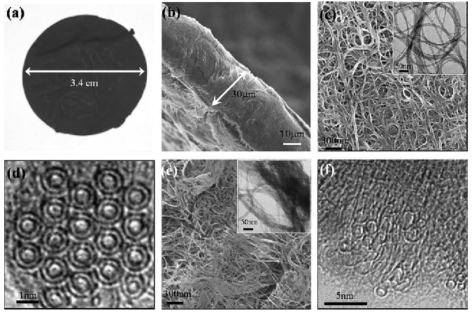
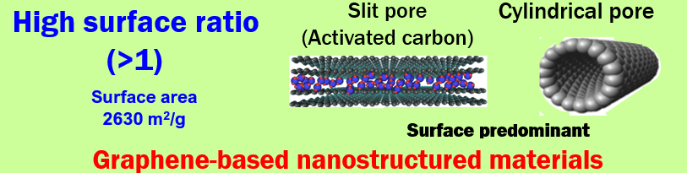
Nanoporous Carbons
Intermittent renewable energy Energy intensive separation
Activated carbon :CDC
SWCNH
Energy storage
Batteries, Capacitors
Adsorbents
Energy friendly
separation

Slide 22
Recent Topics on Carbon Nanostructures
Energy Storage
Partial breaking of Coulombic law Capacitors—storage
Nature Materials （２０１７）
Ambient pressure storage of pressurized methane
Nature Energy (2025) Long-range energy storage
Extremely safe energy storage route
Nature Nanotechnology （２０２４） Mechanical energy
Separation
Graphene-crystal interfaces induced membrane function
Science Adv（２０２２） 2D nanochannels
Hydrophobic confinement-induced water and ions separation
J. Phys. Chem. C (2024）
D₂O phobicity of graphene oxide
Nature Comm. (2024)
Preference in hydrogen bonding formation
Sub-nanoscale in-solid space characterization
with positroniums (0.1nm) Carbon (2025)

Slide 23
Collaborators
Shinshu University
RISM: ARG: Prof. H. Otsuka, Dr. A. Furuse, Prof. H. Tanaka, Dr. S. Wang,
Dr. F. Vallejos-Burgos (USA), Dr. R. Kukobat(Bosnia-H.) Y. Nagata
Science: Prof. T. Iiyama, Dr. R. Futamura, Y. Kawamata, K. Kubo
Eng. and Textile Eng. : Prof. T. Sakai, Prof. T. Hayashi, Dr. K.Fujisawa, Prof. Y. Hattori
Waseda University Dr. M. Sakai, Prof. M. Matsukata
Nagasaki University Prof.K. Urita, Dr. Notohara, Prof. I. Moriguchi
Chiba University Prof. H. Kanoh Prof. T. Ohba
Suwa University of Science Prof. S. Utsumi
Osaka University Prof. T.Ueda
University of Paul Sabatier of Toulouse France Dr. J. Segalini, Prof. P. Simon
Drexel University USA Prof. Y. Gogotsi
Birminghum University UK Prof. M. Biggs
Sorbonne Universités France Prof. M. Salanne
University of Paris France Prof. Francois-Xavier Coudert
Michigan University USA Prof. C. Lastoskie
Michigan State University USA Prof. D. Tomanek
Alicante University Spain Prof. J. Silvestre-Albero
City College of Newy York USA Prof. T. Bandosz
The University of Montpellier France Prof. R. J. M. Pelenq

Slide 24
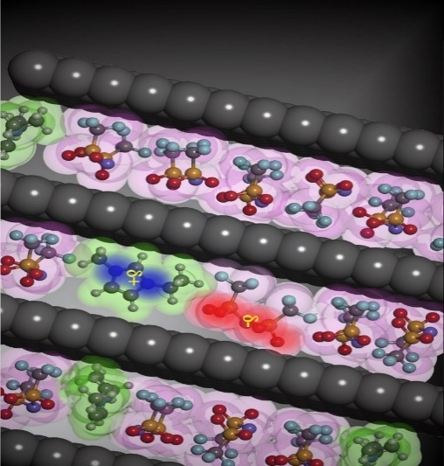

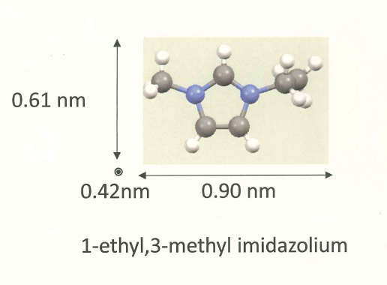
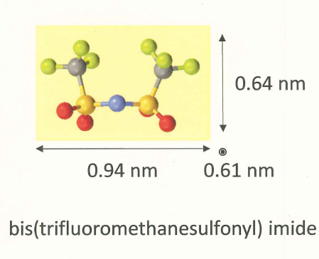




Intermolecular Structure of
Ionic Liquid in Carbon Nanopores
Quasi-Partial breaking of Coulombic law
EMI cation TFSI anion
Dr. R. Futamura
+
-
Prof. T. Iiyama
Electron number(EMI) = 61
Electron number (TFSI) = 137
Dr. J. Segalini
X-ray cross-section of TFSI is almost twice of that of EMI
R. Futamura, T. Iiyama, Y. Takasaki, Y. Gogotsi, M. J. Biggs, M. Salanne,
J. Ségalini, P. Simon, K. Kaneko, Nature Materials, 16, 1225 (2017)
Prof. P. Simon

Slide 25
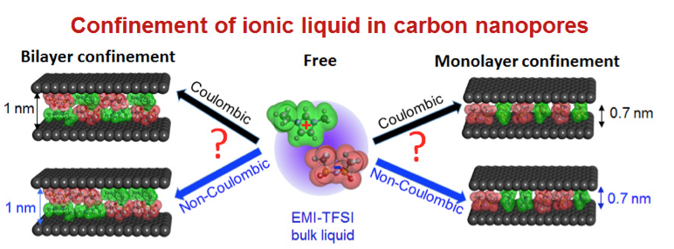
Conceptual Structure Models of EMI-TFSI Confined inside Carbon Nanopores with or without Coulombic Ordering

Slide 26
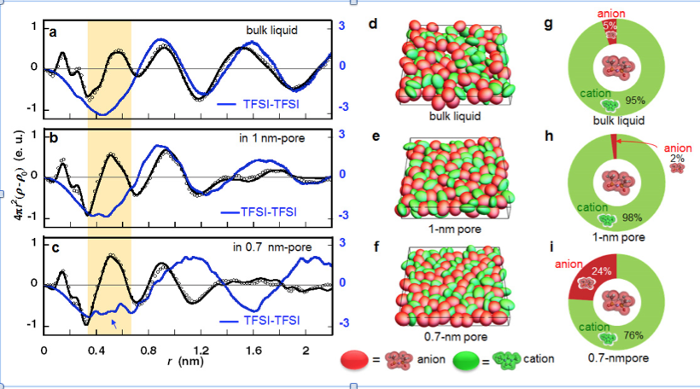
Anion - Anion Structures
Occupation % of anions
around an anion
Electron radial distribution function of anion-anion
Snapshot

Slide 27
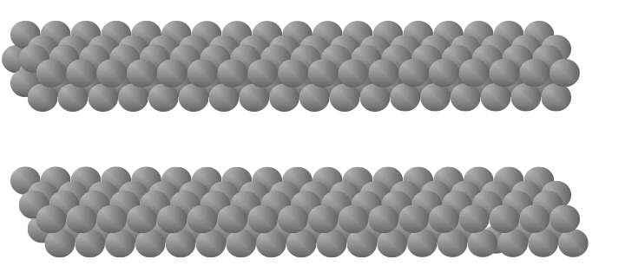
Image Charges Induce Accumulation of
Co-ions in Conductive Carbon Pores
Repulsive energy: + 12 kJ/mol
Attractive interaction due to image charges - 21 kJ/mol
ー
ー
＋
＋
Why anion-anion contact ?
ー
0.5nm
ー
ー
ー
＋
＋
S. Kondrat and A. Kornyshev,
Superionic state in double-layer capacitors
J. Phys:Condens. Matter. 23, 022201 (2011)

Slide 28
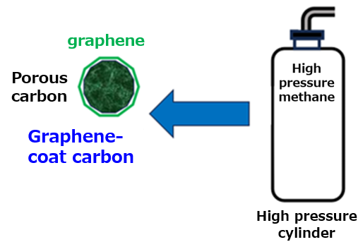
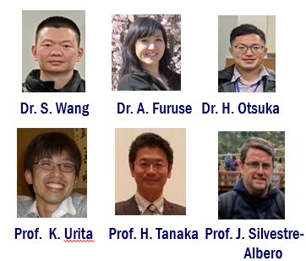
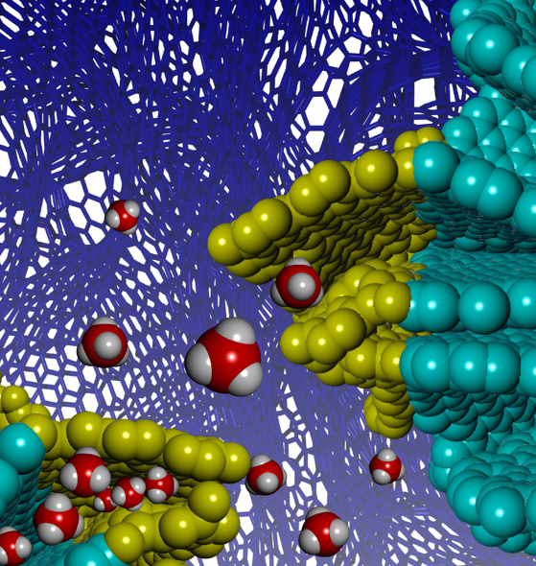
Ambient pressure storage of high-density methane in nanoporous carbon coated
with graphene
S.Wang, F.Vallejos-Burgos, A. Furuse, J. P. Marco-Lozar,
H. Otsuka, M. Nagae,Y. Kawamata, H. Kanoh, K. Urita,
H. Notohara, I. Moriguchi, H. Tanaka,
J. Silvestre-Albero, T. Hayashi, K. Kaneko,
Nature Energy, https://doi.org/10.1038/s41560-025-01783-z
木曜 国際セッション Dr. Wang 発表予定

Slide 29
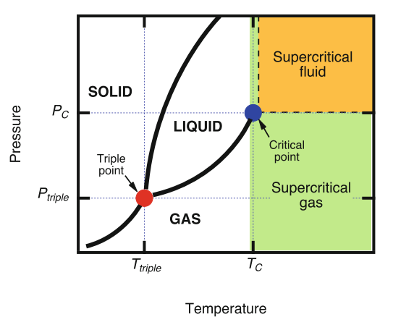


Supercritical gas cannot be sufficiently
physiosorbed even on nanoporous materials
Critical temp. T_{C}
H₂ 33 K
CH₄ 196 K
Widom line
Supercritical gas
cannot condense
Even at high pressure
How can we store supercritical gas
at high density?
Adsorption Natural
Gas (ANG)?

Slide 30
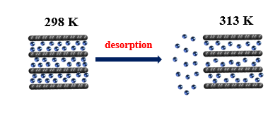
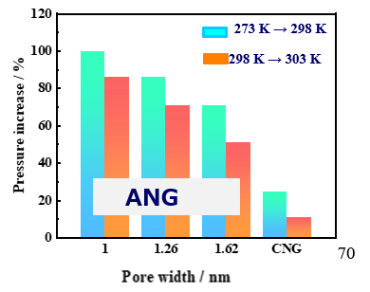
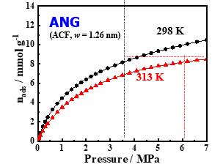
The issue of ANG – Temperature elevation
induces non-negligible desorption
Desorption by heat of adsorption
Pressure increase due to
desorption on temperature change for carbon for carbon of different pore width
Pressure increase
Any new method？

Slide 31
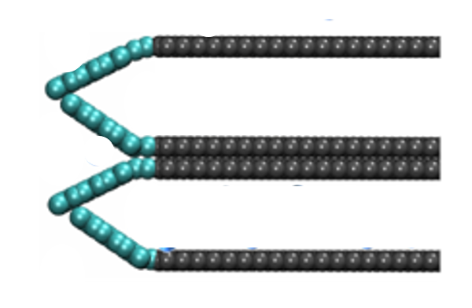
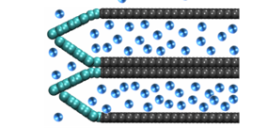
A New Approach
Thermally Tunable Graphene Valves
at Pore Entrance
Pore wall
Pore
Graphene
nanovalves
Methane-CVD
Waste-heat utilization: 473 K

Slide 32
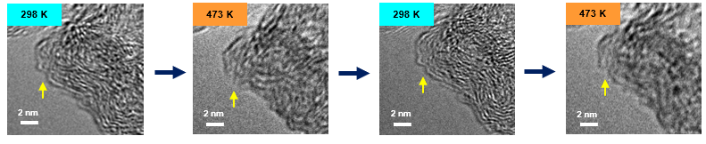
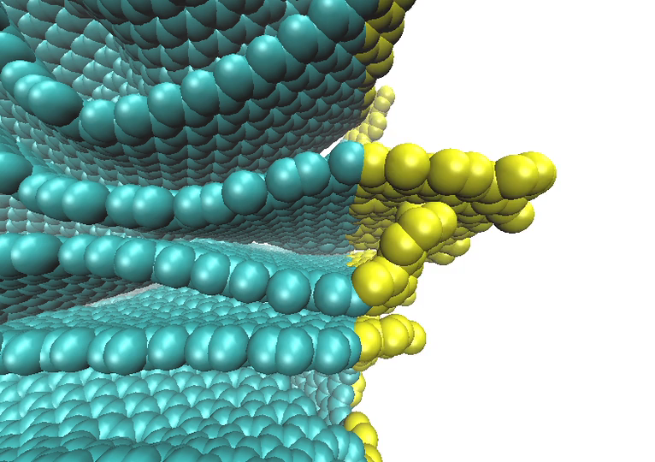

Valve function of graphene layers
In situ TEM images on temperature change （Nagasaki Univ）
Close Open Close Open
Model structural change from MD
298 K
473 K

Slide 33







Storage of high pressure methane
in carbon nanopores
through temperature-driven graphene valves
25MPa
CH₄
_{Storage}
_{Releasing}
_{Storage at ambient}
_{pressure}

Slide 34

Largest methane storage amount of graphene-coated carbon
Even at 30 % filling of pores
Entrance-wrapped carbon in this study: red star, ANG using porous carbons: black dot, ANG using MOFs: dark-green diamond. ANG is conducted at 298 K.
The delivery capacities of CNG and reported ANG are amended by taking account of the weight and real occupied volume of the storage containers.

Slide 35






New Giant Energy Storage Route
Mechanical Energy storage
Prof. S. Utsumi Dr. S. Kumar-Ujjain Dr. A. Furuse Prof. T. Hayashi
Prof. D. Tomanek
S. Utsumi, S. K. Ujjain, S. Takahashi, R. Shomodomae, T, Tamaura, R. Okuda, R. Kobayashi,
O. Takahashi, S. Miyzono, N. Kato, K. Aburamoto, Y. Kosoi, P. Ahuja, A. Furuse, Y. Kawamura,
H. Otsuka, K. Fujisawa, T. Hayashi, D. Tomanek, K. Kaneko
Nature Nanotechnology, 19, 1007-1015(2024)
月曜 発表済み

Slide 36





Energy Storage of Twisting of SWCNT
SWCNT
SWCNT rope
Twisting energy
measurement
Gravimetric energy density of SWCNT rope
Twisting SWCNT
SWCNＴrope
Li ion battery

Slide 37


Twisted SWCNT can move a car
SWCNT rope

Slide 38




Graphene-Crystal Interfaces-Induced Membrane Separation
R. Kukobat, M. Sakai, H. Tanaka, H. Otsuka, Fe. Vallejos-Burgos,
C. Lastoskie, M. Matsukata, Y. Sasaki, K. Yoshida, T. Hayashi, K. Kaneko,
Science Advances, 8, eabl3521 (1-11) (2022)
Dr. R. Kukobat Prof. H. Tanaka Prof. C. Lastoski Prof. M. Matsukata

Slide 39






New Membranes
Originated from Graphene-Crystal Face Interfacial Spaces
Nanowindows
Graphene
TEM images
MFI
２D nanochannels
Wrapping of a MFI zeolite crystal with graphenes
Compression
5 mm
membrane

Slide 40



Promising Membrane for H₂/CH₄ Separation
H₂ economy is promising for Sustainable Society.
H₂ is mainly produced through steam reforming of natural gas.
The energy-saving recovery of H₂ from refinery streams containing H₂, CH₄,
and light hydrocarbons is intensively demanded.
Robeson plot for H₂/CH₄
Stability of G-MFI membrane
Dr. R. Kukobat
R. Kukobat et al. Science Adv.
2022. 8, eabl3521 (1-11).
40

Slide 41



Membrane Characteristics of Graphene-wrapped MFI
Permeability
Selectivity of H₂ against other gases
Robeson plot for CO₂/CH₄

Slide 42

Graphene-Wrapped Zeolite Particle
Wrapping
gives subnanoscale gaps between
graphene layers and MFI surface
---------------- Molecular sieving
Bridging graphene-wrapped zeolite
crystals to enhance the particle-particle
contact, reducing leakage

Slide 43






Air Separation: O₂ (N₂)-Enriched Gas
Air separation method
Present membrane method is the most energy saving, but not productive.
We need to develop Extremely Rapid Membrane Separation Technology
Rapid separation: O₂ enriched gas
Air

Slide 44




Graphene-Wrapped Zeolite (MFI) Membrane of N₂ Selectivity
G-MFI membrane
higher selectivity and larger permeance
G-wrapped MFI
MFI without wrapping
Upper bound in 2008
N₂ selective membranes can provide O₂ enriched air of a higher pressure
本日一部発表
A. Furuse, H. Otsuka In preparation

Slide 45




Evidence on Intrinsic Graphene Oxide We must use intrinsic graphene oxide for wrappnig
Prof. H. Otsuka Prof. K. Urita Prof. T.Bandosz
H. Otsuka, K .Urita, N.Honma,T. Kimuro, Y. Amako, R. Kukobat,
T. J. Bandosz, J. Ukai, I. Moriguchi, K. Kaneko, Nature Comm. 15, 1708(1-10) (2024).

Slide 46





Separated Structure of KCl solution and Water inside highly crystalline single wall carbon nanotube?
2 nm
Quasi-ice nanotube formation
on hydrophobic graphene wall
K⁺
Cl⁻
”Concentric structure of coexistent KCl core solution and water adlayer inside highly hydrophobic single wall carbon nanotube”
Cl⁻
K⁺
Y. Kawamata, H. Otshuka, R. Futamura, T. Iiyama, K.Kaneko, J. Phys. Chem. C, 128, 12632 (2024).
1 wt.% , 4 wt.% KCl solutions
inside SWCNT
in situ X-ray scattering and
GCMC simulation

Slide 47






審査中、準備中 期待できる研究
Staggered Structural Dynamic-mediated
Selective Adsorption of H₂O/D₂O
on Flexible Graphene Oxide Nanosheets
Dr.R. Futamura Prof. T. Iiyama Prof. H. Tanaka Dr. A. Furuse
Prof. T. Ueda Prof. F X Coudert P rof. R. Pellenq
GO can distinguish H₂O and D₂O
R. Futamura, T. Iiyama, T. Ueda, P. A. Bonnaud,
F.-X. Coudert , A. Furuse, H. Tanaka,
R. J. -M. Pellenq, K. Kaneko,
Nature Comm. 15, 3585 (1-12) (2024)

Slide 48




Stacking Structure of GO layers
In-site XRD profiles
Structure Simulation of H₂O/GO
GO
GO
water
Questions
Ordered layer structure ?
Ordered stacking structure ?
Flexible stacking layer structure ?
Adsorbed state of water ?
Selective adsorption of
H₂O against D₂O ?
B. Lian et al., Chem. Sci. 2018 9, 5106

Slide 49



Staggered Structure
of Flexible Graphene Oxide Nanosheets
Before water adsorption
After water adsorption
The staggered structure can interpret
swelling nature upon water adsorption
Also the staggered structure induces
rapid diffusion of water

Slide 50

Staggered Structure of
Flexible Graphene Oxide Nanosheets

Slide 51



Selective Adsorption of GO for H₂O and D₂O
Single component adsorption isotherms for H₂O and D₂O
298 K
P/P₀
Mixed gas adsorption of H₂O and D₂O at P/P₀ = 0.98
298 K

Slide 52



Importance of Fine Characterization of Nanoscale In-Pore Spaces
Molecular probe method using gas adsorption
Difficulty in ultramicropore characterization w< 0.7 nm
N₂ : O.33 nm Ar: 0.34 nm
Positron lifeーtime spectroscopy (PALS) annihilation
Probe: o-positronium (Ps) (0.10 nm)
o-positroniums created on collision of positrons with electrons in the solid wall emits γ-ray.
γ ray intensity
A key analysis parameter for carbon
has been determined to be 0.23 nm
K. Kubo et al. Carbon,
245, 120825 (2025).
月曜 発表済み

Slide 53






Acknowledgements
JST OPERA (2017- 2021)
NEDO Air separation (2021-2022)
NEDO Membranes (2023-2025)
Takagi Research Fund (2013- )
JSPS Grant-in-Aid A and B
JST CREST “Creation of Innovative Functional Materials
with Advanced Properties
by Hyper-nano-space Design” (2013—2018)
Synchrotron Facility:
Aichi Synchrotron Center

Slide 54

The 50th Anniversary
of Colloid and Surface Chemistry Division
Pilgrimage for Scientific Understanding on materials
Thank you

